Slide 1
TITLE
Kyle Dahlin, Michael Robert, and Lauren Childs
Virginia Tech, Department of Mathematics
Contact: kyledahlin@vt.edu
EVENT SESSION CITY, STATE, COUNTRY

Slide 2
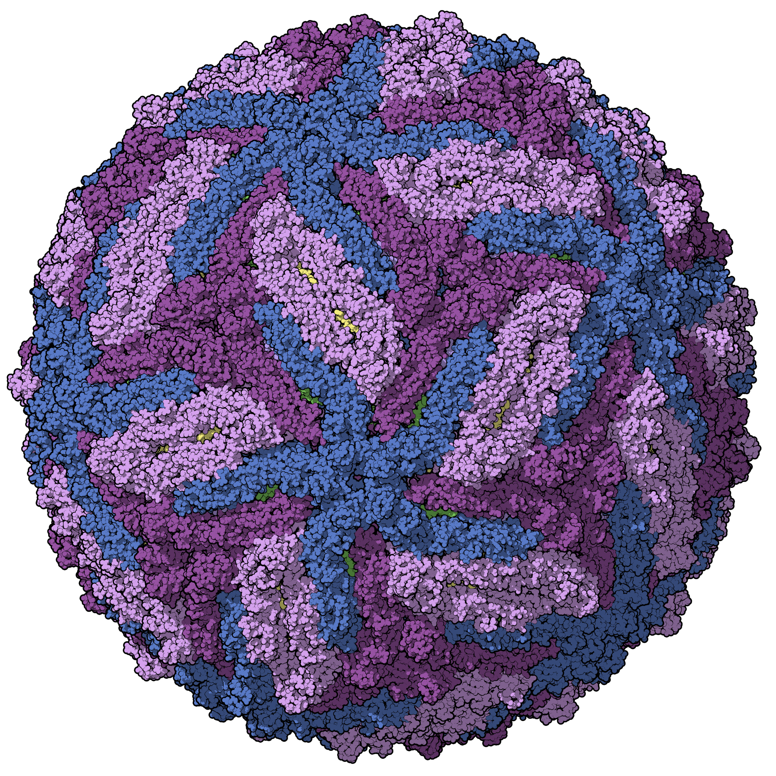
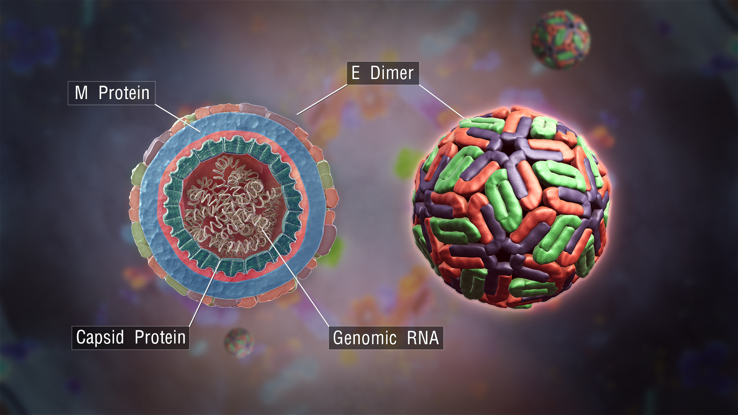
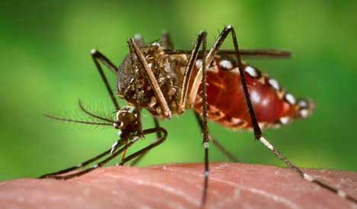
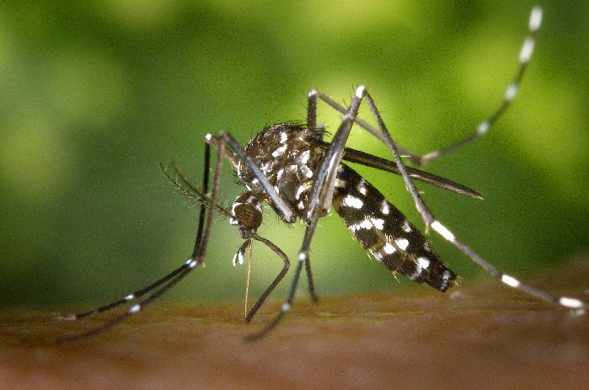
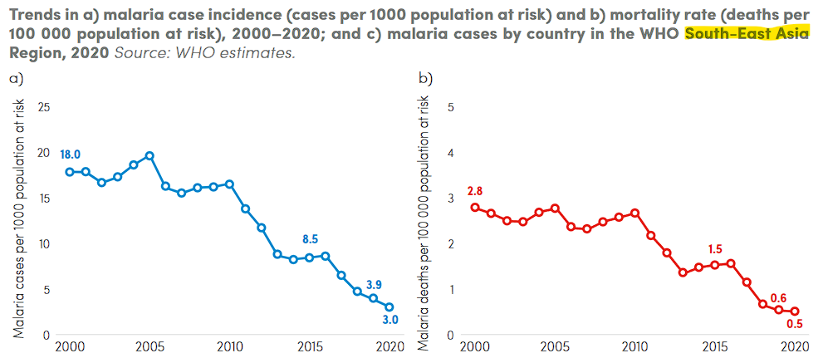
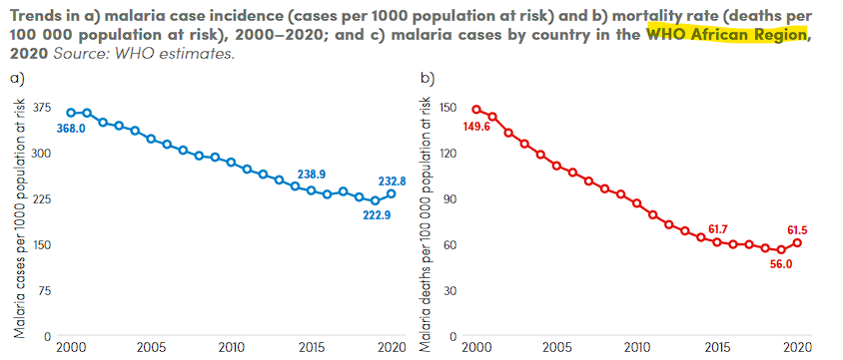
Mosquito-borne diseases (MBDs)
Annually, over 200 million cases of malaria and up to 400 million cases of dengue
>25% recent emerging infectious disease outbreaks were due to MBDs (Jones 2008, Gould 2017)
Despite successful mitigation and suppression programs, malaria has seen a recent uptick in some regions (World Malaria Report 2021)
Predicting MBD outbreaks is complex, needing to account for:
ecology of multiple hosts,
life history of the insect vectors, and
the traits of the pathogens themselves
Dengue virus virion (ScientificAnimations.com)
Zika virus virion
(Manuel Almagro Rivas)
Aedes aegypti (CDC.gov)
Aedes albopictus (CDC.gov)
Historical malaria incidence:
South-East Asia region
Africa region

Slide 3

The blood feeding process
Locate host
“Questing”
“Successful hematophagy culminates in an intricate cascade of events.” – John D. Edman and Andrew Spielman
Landing on host
Probing
Ingesting
Repletion:
Proceed to oviposition stage

Slide 4
The blood feeding process
Newly-emerged mosquitoes and those that have recently finished ovipositing
Locate host
“Questing”
Landing
Probing
Depart and quest for new host
Feeding failure
Ingesting
Repletion:
Proceed to oviposition stage
Persist on same host
Notes:
Maybe: combine probing, salivation, and feeding then break them out later when focusing on transmission

Slide 5
Blood feeding
Successful locating
Successful landing
Successful probing
Successful ingesting
Failed locating
Failed landing
Failed probing
Failed ingesting
Oviposition
Notes:
Maybe: combine probing, salivation, and feeding then break them out later when focusing on transmission

Slide 6
Failed locating or
Failed landing or
Failed probing or
Failed ingesting
Failed locating or
Failed landing or
Failed probing or
Failed ingesting
Blood feeding
Blood feeding again
Blood feeding again
again
Successful locating&
Successful landing&
Successful probing&
Successful ingesting.
Oviposition
Notes:
Maybe: combine probing, salivation, and feeding then break them out later when focusing on transmission

Slide 7



$$q=\text{Pr}\left(\text{successful} \text{landing}\right)$$
$$l=\text{Pr}\left(\text{successful} \text{landing}\right)$$
$$p=\text{Pr}\left(\text{successful} \text{probing}\right)$$
$$g=\text{Pr}\left(\text{successful} \text{ingesting}\right)$$
$$B_{i}$$
$$B_{i+1}$$
Questing
Landing
Probing
Feeding failure
Depart and quest for new host
Ingesting
Persist on same host
Notes:
Maybe: combine probing, salivation, and feeding then break them out later when focusing on transmission

Slide 8













$$p_{Q}=\text{Pr}\left(\text{successful} \text{questing}\right)$$
$$p_{L}=\text{Pr}\left(\text{successful} \text{landing}\right)$$
$$f=\text{Pr}\left(\text{search} \text{for} \text{new} \text{host}\right)$$
$$p_{P}=\text{Pr}\left(\text{successful} \text{probing}\right)$$
$$p_{G}=\text{Pr}\left(\text{successful} \text{ingesting}\right)$$
$λ_{Q}=\text{Rate} \text{from} \text{Questing} \text{to} \text{Landing}$
$λ_{L}=\text{Rate} \text{from} \text{Landing} \text{to} \text{Probing}$
$λ_{P}=\text{Rate} \text{from} \text{Probing} \text{to} \text{Ingesting}$
$λ_{G}=\text{Rate} \text{from} \text{Ingesting} \text{to} \text{Oviposition}$
$$\left(1−p_{L}\right)\left(1−f\right)λ_{L}$$
$$B_{i}$$
$$\left(1−p_{P}\right)\left(1−f\right)λ_{P}$$
Questing
$$p_{Q}λ_{Q}$$
Landing
$$p_{L}λ_{L}$$
Probing
$$p_{P}λ_{P}$$
Ingesting
$$p_{G}λ_{g}$$
$$\left(1−p_{L}\right)fλ_{L}$$
$$\left(1−p_{G}\right)λ_{G}$$
$$\left(1−p_{P}\right)fλ_{P}$$
Feeding failure
Depart and quest for new host
$$B_{i+1}$$
Persist on same host
Notes:
Maybe: combine probing, salivation, and feeding then break them out later when focusing on transmission

Slide 9













$$p_{Q,i}=\text{Pr}\left(\text{successful} \text{questing}\right)$$
$$p_{L,i}=\text{Pr}\left(\text{successful} \text{landing}\right)$$
$$f_{i}=\text{Pr}\left(\text{search} \text{for} \text{new} \text{host}\right)$$
$$p_{P,i}=\text{Pr}\left(\text{successful} \text{probing}\right)$$
$$p_{G,i}=\text{Pr}\left(\text{successful} \text{ingesting}\right)$$
$λ_{q}=\text{Rate} \text{from} \text{Questing} \text{to} \text{Landing}$
$λ_{l}=\text{Rate} \text{from} \text{Landing} \text{to} \text{Probing}$
$λ_{p}=\text{Rate} \text{from} \text{Probing} \text{to} \text{Ingesting}$
$λ_{g}=\text{Rate} \text{from} \text{Ingesting} \text{to} \text{Oviposition}$
$$\left(1−p_{L}\right)\left(1−f\right)λ_{L}$$
$$B_{i}$$
$$\left(1−p_{P}\right)\left(1−f\right)λ_{P}$$
$$Q_{i}$$
$$p_{Q}λ_{Q}$$
$$L_{i}$$
$$p_{L}λ_{L}$$
$$P_{i}$$
$$p_{P}λ_{P}$$
$$G_{i}$$
$$p_{G}λ_{g}$$
$$\left(1−p_{L}\right)fλ_{L}$$
$$\left(1−p_{P}\right)fλ_{P}$$
$$\left(1−p_{G}\right)fλ_{G}$$
$$\left(1−p_{G}\right)\left(1−f\right)λ_{G}$$
$$Q_{i+1}$$
$$L_{i+1}$$
$$P_{i+1}$$
$$G_{i+1}$$
Notes:
Maybe: combine probing, salivation, and feeding then break them out later when focusing on transmission

Slide 10











$$q=\text{Pr}\left(\text{successful} \text{questing}\right)$$
$$l=\text{Pr}\left(\text{successful} \text{landing}\right)$$
$$f=\text{Pr}\left(\text{search} \text{for} \text{new} \text{host}\right)$$
$$p=\text{Pr}\left(\text{successful} \text{probing}\right)$$
$$g=\text{Pr}\left(\text{successful} \text{ingesting}\right)$$
$λ_{q}=\text{Rate} \text{from} \text{Questing} \text{to} \text{Landing}$
$λ_{l}=\text{Rate} \text{from} \text{Landing} \text{to} \text{Probing}$
$λ_{p}=\text{Rate} \text{from} \text{Probing} \text{to} \text{Ingesting}$
$λ_{g}=\text{Rate} \text{from} \text{Ingesting} \text{to} \text{Oviposition}$
$$\left(1−p\right)\left(1−f\right)λ_{p}+\left(1−g\right)\left(1−f\right)λ_{g}$$
$$\left(1−l\right)fλ_{l}+\left(1−p\right)fλ_{p}$$
$$Q_{i}$$
$$λ_{q}$$
$$B_{i}$$
$$gλ_{g}$$
$$V$$
$$\left(1−g\right)λ_{g}$$
Feeding failure
$$Q_{i+1}$$
$$λ_{q}$$
$$B_{i+1}$$
Depart and quest for new host
Persist on same host
Notes:
Maybe: combine probing, salivation, and feeding then break them out later when focusing on transmission

Slide 11

$$q=\text{Pr}\left(\text{successful} \text{questing}\right)$$
$$l=\text{Pr}\left(\text{successful} \text{landing}\right)$$
$$f=\text{Pr}\left(\text{search} \text{for} \text{new} \text{host}\right)$$
$$p=\text{Pr}\left(\text{successful} \text{probing}\right)$$
$$g=\text{Pr}\left(\text{successful} \text{ingesting}\right)$$
$λ_{q}=\text{Rate} \text{from} \text{Questing} \text{to} \text{Landing}$
$λ_{l}=\text{Rate} \text{from} \text{Landing} \text{to} \text{Probing}$
$λ_{p}=\text{Rate} \text{from} \text{Probing} \text{to} \text{Ingesting}$
$λ_{g}=\text{Rate} \text{from} \text{Ingesting} \text{to} \text{Oviposition}$
$$\left(1−p\right)\left(1−f\right)λ_{p}+\left(1−g\right)\left(1−f\right)λ_{g}$$
$$\left(1−l\right)fλ_{l}+\left(1−p\right)fλ_{p}$$
$$Q_{i}$$
$$λ_{q}$$
$$B_{i}$$
$$gλ_{g}$$
$$V$$
$$\left(1−g\right)λ_{g}$$
Feeding failure
$$Q_{i+1}$$
$$λ_{q}$$
$$B_{i+1}$$
Depart and quest for new host
$\text{FOI}\text{=}β_{p}λ_{p}∑P_{i}+β_{g}λ_{g}∑G_{i}$
$P_{i}≈\frac{λ_{l}}{λ_{l}+λ_{p}+λ_{g}}B_{i},G_{i}≈\frac{λ_{p}}{λ_{l}+λ_{p}+λ_{g}}B_{i}$???
Persist on same host
Notes:
Maybe: combine probing, salivation, and feeding then break them out later when focusing on transmission

Slide 12



$$q=\text{Pr}\left(\text{successful} \text{questing}\right)$$
$$l=\text{Pr}\left(\text{successful} \text{landing}\right)$$
$$f=\text{Pr}\left(\text{search} \text{for} \text{new} \text{host}\right)$$
$$p=\text{Pr}\left(\text{successful} \text{probing}\right)$$
$$g=\text{Pr}\left(\text{successful} \text{ingesting}\right)$$
$λ_{q}=\text{Rate} \text{from} \text{Questing} \text{to} \text{Landing}$
$λ_{l}=\text{Rate} \text{from} \text{Landing} \text{to} \text{Probing}$
$λ_{p}=\text{Rate} \text{from} \text{Probing} \text{to} \text{Ingesting}$
$λ_{g}=\text{Rate} \text{from} \text{Ingesting} \text{to} \text{Oviposition}$
$$\left(1−p\right)λ_{p}+\left(1−g\right)\left(1−f\right)λ_{g}+\left(1−l\right)fλ_{l}$$
$$\left(1−p\right)\left(1−f\right)λ_{p}+\left(1−g\right)\left(1−f\right)λ_{g}$$
$$\left(1−l\right)fλ_{l}+\left(1−p\right)fλ_{p}$$
$$B_{i}$$
$$gλ_{g}$$
$$V$$
$$\left(1−g\right)λ_{g}$$
$λ_{p}$is contact rate for transmission to host
$λ_{g}$is contact rate for transmission to vector
Feeding failure
$$B_{i+1}$$
Depart and quest for new host
$\text{FOI}\text{=}β_{p}λ_{p}∑P_{i}+β_{g}λ_{g}∑G_{i}$
$P_{i}≈\frac{λ_{l}}{λ_{l}+λ_{p}+λ_{g}}B_{i},G_{i}≈\frac{λ_{p}}{λ_{l}+λ_{p}+λ_{g}}B_{i}$???
Persist on same host
Notes:
Maybe: combine probing, salivation, and feeding then break them out later when focusing on transmission

Slide 13



$$q=\text{Pr}\left(\text{successful} \text{questing}\right)$$
$$l=\text{Pr}\left(\text{successful} \text{landing}\right)$$
$$f=\text{Pr}\left(\text{search} \text{for} \text{new} \text{host}\right)$$
$$p=\text{Pr}\left(\text{successful} \text{probing}\right)$$
$$g=\text{Pr}\left(\text{successful} \text{ingesting}\right)$$
$λ_{q}=\text{Rate} \text{from} \text{Questing} \text{to} \text{Landing}$
$λ_{l}=\text{Rate} \text{from} \text{Landing} \text{to} \text{Probing}$
$λ_{p}=\text{Rate} \text{from} \text{Probing} \text{to} \text{Ingesting}$
$λ_{g}=\text{Rate} \text{from} \text{Ingesting} \text{to} \text{Oviposition}$
$$\left(1−p\right)\left(1−f\right)λ_{p}+\left(1−g\right)\left(1−f\right)λ_{g}$$
$$\left(1−l\right)fλ_{l}e^{−μ/λ_{q}}+\left(1−p\right)fλ_{p}e^{−μ/λ_{q}}$$
$$B_{i}$$
$$gλ_{g}$$
$$V$$
$$\left(1−g\right)λ_{g}$$
Feeding failure
$λ_{p}$is contact rate for transmission to host
$λ_{g}$is contact rate for transmission to vector
$$B_{i+1}$$
Depart and quest for new host
$\text{FOI}\text{=}β_{p}λ_{p}∑B_{i}+β_{g}λ_{g}∑B_{i}$
$P_{i}≈\frac{λ_{l}}{λ_{l}+λ_{p}+λ_{g}}B_{i},G_{i}≈\frac{λ_{p}}{λ_{l}+λ_{p}+λ_{g}}B_{i}$???
Persist on same host
Notes:
Maybe: combine probing, salivation, and feeding then break them out later when focusing on transmission

Slide 14
























$$gλ_{g}$$
$$S_{V}$$
$$S_{1}$$
$$q=\text{Pr}\left(\text{successful} \text{questing}\right)$$
$$l=\text{Pr}\left(\text{successful} \text{landing}\right)$$
$$f=\text{Pr}\left(\text{search} \text{for} \text{new} \text{host}\right)$$
$$p=\text{Pr}\left(\text{successful} \text{probing}\right)$$
$$g=\text{Pr}\left(\text{successful} \text{ingesting}\right)$$
$$δ$$
$$S_{i}$$
$$\left(1−g\right)λ_{g}$$
$$S_{i+1}$$
$$Λ_{V}$$
$$gλ_{g}$$
$$E_{1}$$
$λ_{q}=\text{Rate} \text{from} \text{Questing} \text{to} \text{Landing}$
$λ_{l}=\text{Rate} \text{from} \text{Landing} \text{to} \text{Probing}$
$λ_{p}=\text{Rate} \text{from} \text{Probing} \text{to} \text{Ingesting}$
$λ_{g}=\text{Rate} \text{from} \text{Ingesting} \text{to} \text{Oviposition}$
$$E_{V}$$
$$δ$$
$$E_{i}$$
$$\left(1−g\right)λ_{g}$$
$$E_{i+1}$$
$$η$$
$$I_{1}$$
$$I_{V}$$
$$gλ_{g}$$
$$I_{i}$$
$$\left(1−g\right)λ_{g}$$
$$I_{i+1}$$
${Λ_{H}=\text{FOI}}_{\text{host}}=\frac{\sum{B_{i}}}{H}\left(β_{h,p}λ_{p}\right)\frac{\sum{I_{i}}}{B_{i}}$
${Λ_{V}=\text{FOI}}_{\text{vector}}=\left(β_{v,g}λ_{g}\right)\frac{I_{H}}{H}$
$δ=\text{failure} \text{rate} \text{with} \text{return}=\left(1−p\right)\left(1−f\right)λ_{p}+\left(1−g\right)\left(1−f\right)λ_{g}+\left(1−l\right)fλ_{l}e^{−μ/λ_{q}}+\left(1−p\right)fλ_{p}e^{−μ/λ_{q}}$
Notes:
Maybe: combine probing, salivation, and feeding then break them out later when focusing on transmission

Slide 15













Blood-feeding stages
Oviposition
Aquatic stages
$$L$$
$$S_{1}$$
$$S_{i}$$
$$S_{i+1}$$
$$S_{V}$$
partial feeding
exposure
$$E_{1}$$
$$E_{i}$$
$$E_{i+1}$$
$$E_{V}$$
parasite development
$$I_{1}$$
$$I_{i}$$
$$I_{i+1}$$
$$I_{V}$$
Not shown: return-to-state rate due to feeding failure prior to the ingestion stage

Slide 16













Blood-feeding stages
Oviposition
Aquatic stages
$$L$$
$$S_{1}$$
partial feeding
$$S_{i}$$
$$S_{i+1}$$
$$S_{V}$$
exposure
$$E_{1}$$
$$E_{i}$$
$$E_{i+1}$$
$$E_{V}$$
parasite development
$$I_{1}$$
$$I_{i}$$
$$I_{i+1}$$
$$I_{V}$$
Not shown: return-to-state rate due to feeding failure prior to the ingestion stage

Slide 17
Mechanistic vs. phenomenological vs. empirical models
The model on the previous slide is mechanistic
The disrupt and fate models are phenomenological

Slide 18

Data simulation process
Initialize
Yes = 50%
Questing
No = 50%
Success
Probability of success: 100%
Average duration: 2 days
Quantities measured
Time to reach repletion
Number of partial feeds (failing out of “Ingesting”)
Total time spent in “Questing”
Total time spent in “Landing”
Total time spent in “Probing”
Total time spent in “Ingesting”
Find new host?
Landing
Failure
Success
Probability of success: 75%
Average duration: 10 minutes
Failure
Probing
Success
Probability of success: 75%
Average duration: 5 minutes
Failure
Ingesting
Probability of success: 75%
Average duration: 1 minutes
Success
Repletion

Slide 19
Fitting process
Fitting is achieved by maximum likelihood estimation using an EM algorithm
Fitting is possible with data only on “time to reach repletion” i.e. exit times from the blood-feeding transient stages
However, the parameters are not identifiable in this case: unique parameterizations do not exist for phase-type distributions
They are identifiable if complete data is given (numbers of jumps from transient states, total time spent in each transient state, initial numbers in each state)
Initializing the EM algorithm requires “guesses” for A and alpha. Any zero entries of A and alpha are retained in the algorithm
This allows for assumptions about the structure of A and alpha to be maintained
This allows for comparison of our different models, corresponding to structured matrices and their dimensions

Slide 20
Environmental factors
Humidity
Temperature
Light intensity / illumination
Wind velocity
Atmospheric temperature
Rainfall

Slide 21
Mosquito blood feeding
MBD transmission is driven by mosquito blood-feeding / biting
Measuring the rate at which mosquitoes feed on hosts (the biting rate) is challenging
A common assumption of MBD models is that mosquitoes oviposit (reproduce) after each blood feeding
This allows for the simplifying assumption that
Time between egg-laying events = Time between biting events
But…

Slide 22
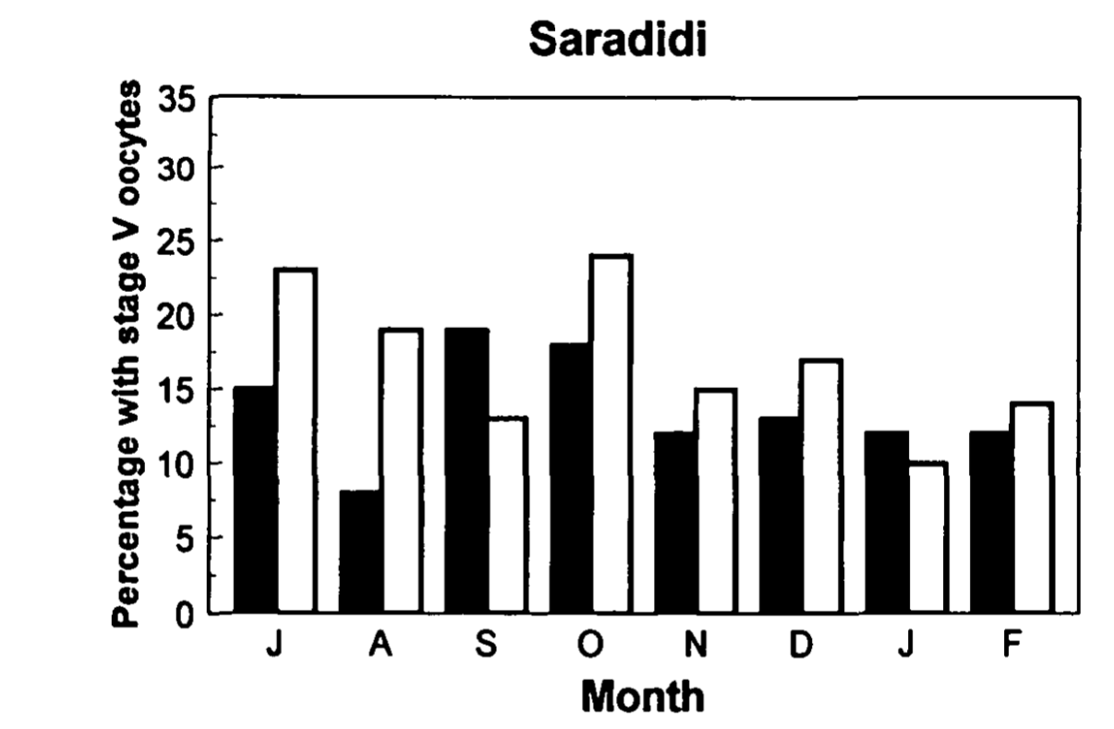
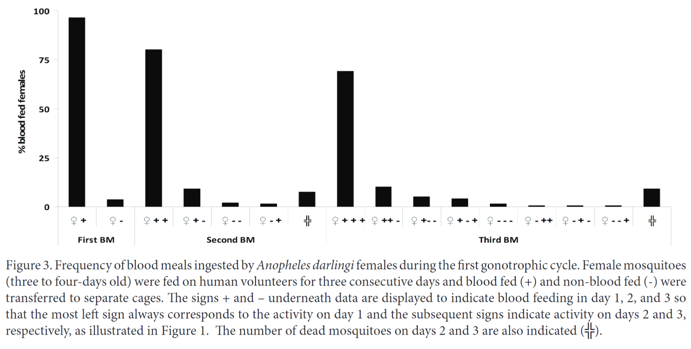
Multiple blood feeding is common
Multiple blood feeding = feeding more than once in a single gonotrophic (reproductive) cycle
Particularly true for Anopheles mosquitoes: the primary culprits in transmission of malaria parasites
1
2
3
1
2
0
0
1
1
2
0
2
1
1
Proportion of Anopheles gambiae and An. Funestus mosquitoes taking an additional blood meal
Modified from Beier (1996) J Med Entomol
Frequency of blood meals ingested by Anopheles darlingi females in a single gonotrophic cycle. Numbers above bars indicate total number of blood meals.
Modified from de Oliveira et al. (2012) J Vector Ecol
Notes:
NB: We use the term “multiple blood feeding” generically to include both interrupted and mixed blood feeding

Slide 23
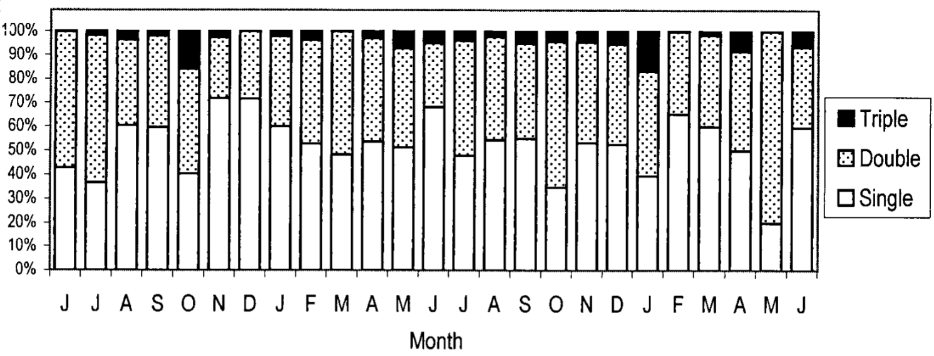
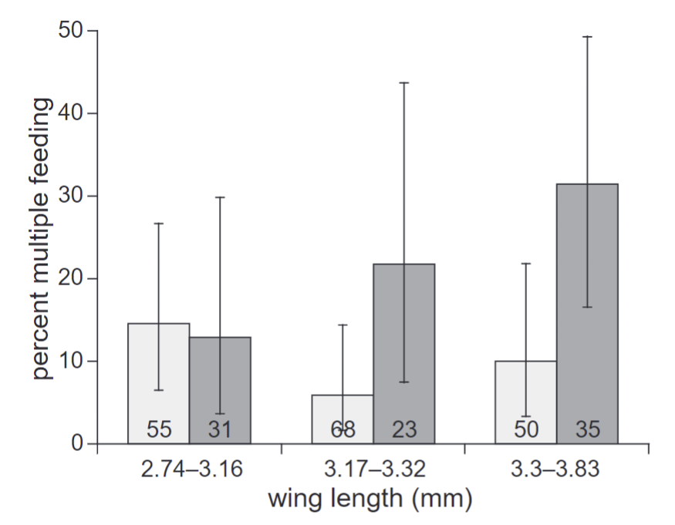
Drivers of multiple blood feeding
Seasonality
Infection status and body size
Uninfected with malaria
Infected with malaria
Seasonality drives patterns in multiple blood feeding for Aedes aegypti
Modified from Scott et al. (2000) J Med Entomol
Effect of size and infection status (Plasmodium falciparum) on the probability of Anopheles gambiae having multiple blood meals
Modified from Koella, et al (1998) Proc Biol Sci
Notes:
Evidence of multiple blood feeding happening regularly

Slide 24
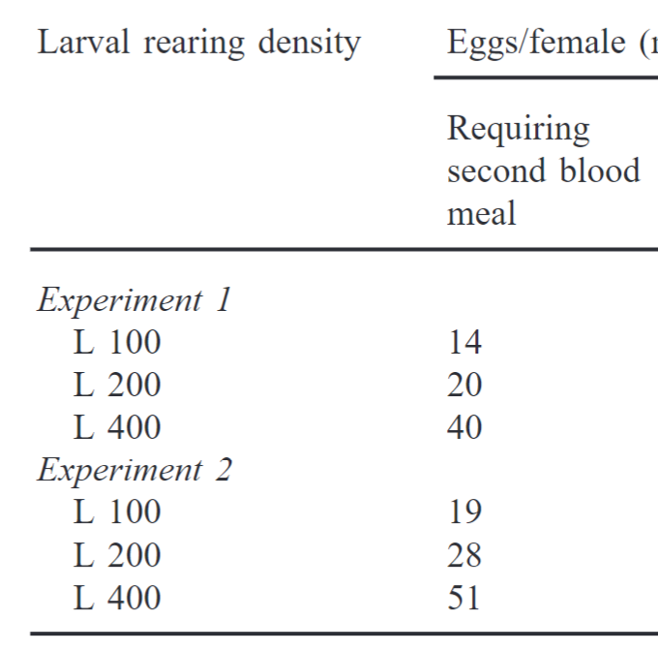
Drivers of multiple blood feeding
Larval conditions
Meal diversity
Feeding on a variety of blood meal sources may lead to higher fecundity
Interruption by host defensive behavior
Mosquitoes may have evolved “flightiness” to avoid destruction by host defenses
Ramasamy et al. (2000) J Insect Physiol

Slide 25
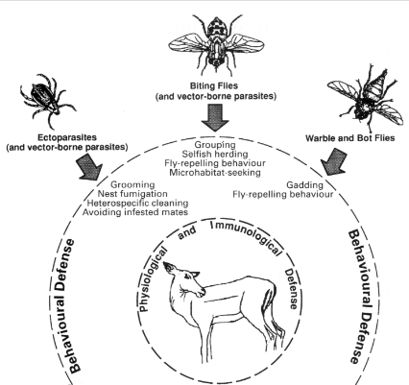
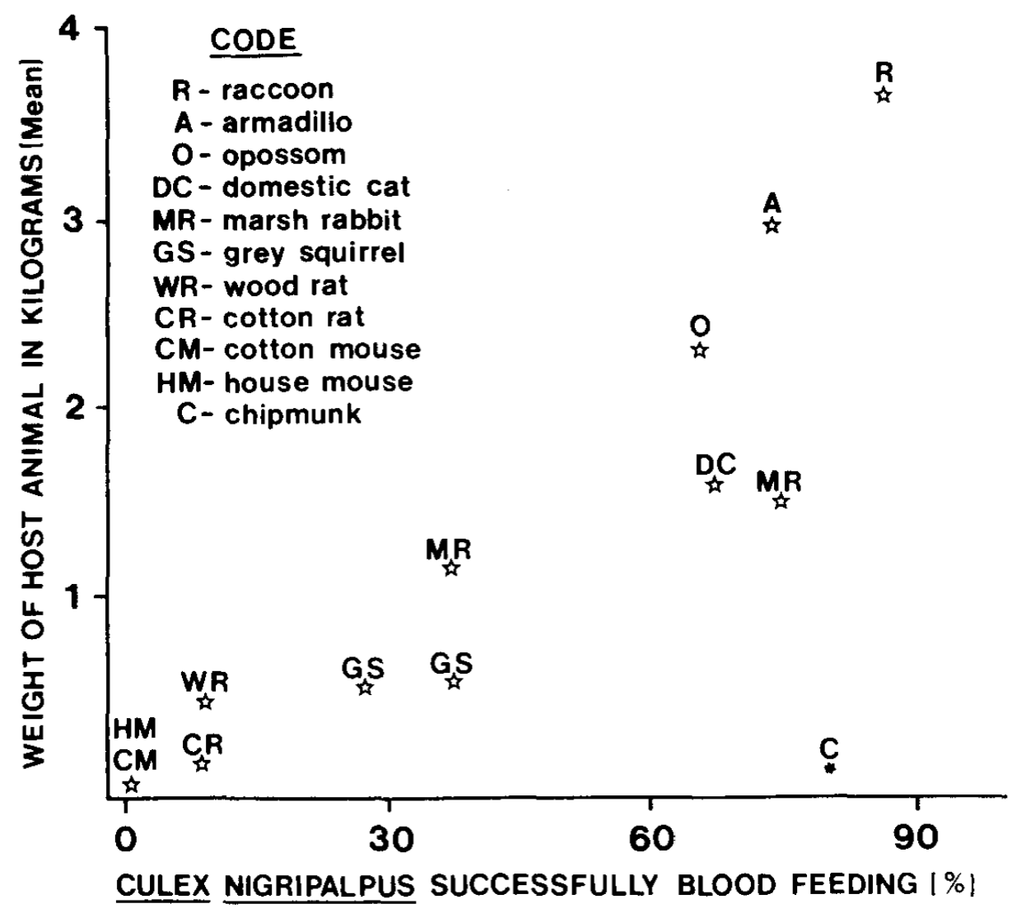
Disruption of blood feeding by hosts
Host defensiveness is tightly linked with body size. Smaller animals more likely to destroy biting flies rather than just disrupt them.
Edman and Scott (1987) Int J Trop Insect Sci
Hosts have an array of defensive strategies they can employ to avoid insect blood feeding
Hart (1994) Parasitology

Slide 26
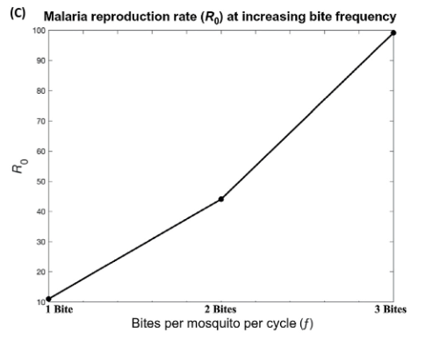
Multiple blood feeding may multiply transmission
More frequent feeding attempts
3x increase in biting frequency
→ 10x increase in in transmission
More frequent contact with hosts
More opportunities for disease transmission
Tedrow, R. E., P. A. Zimmerman, and K. C. Abbott. 2019. Multiple Blood Feeding: A Force Multiplier for Transmission. Trends in parasitology 35:949–952.

Slide 27
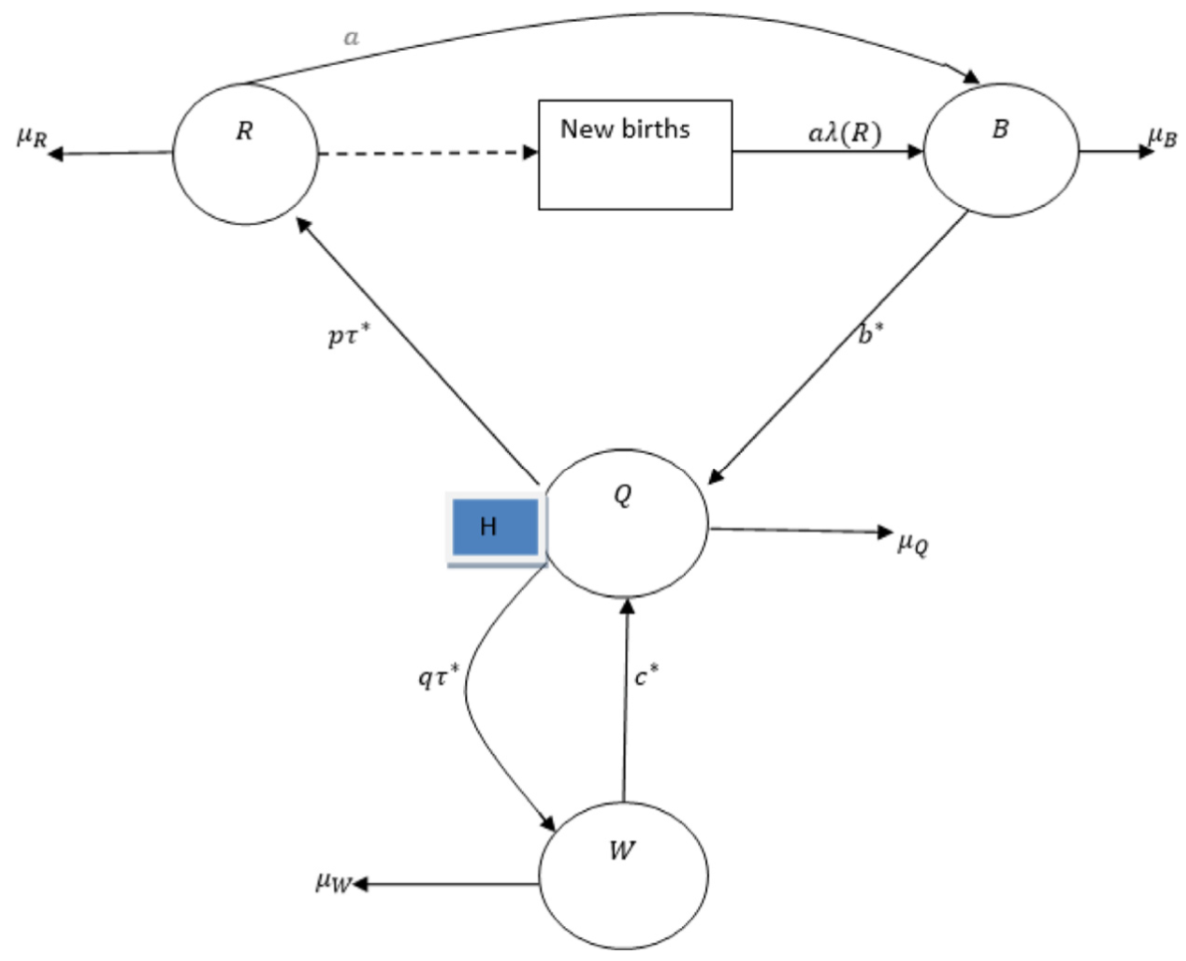
Past models of multiple blood feeding
Many authors have incorporated multiple blood feeding into models by multiplying the contact rate accordingly – as in Tedrow (2019)
Ghakanyuy et al. (2022) explicitly model the possibility of failed blood feeding leading to multiple feeds per gonotrophic cycle
Christofferson et al. (2022) developed an IBM of transmission in a 2-person household, allowing for multiple feeds by the mosquito
Anderson and Roitberg (1999) developed a stochastic simulation model to evaluate relative dis/advantages of multiple blood feeding in regard to mosquito fitness
This list is by no means complete!
Newly emerged
Resting
Successful
blood feeding
Questing
Failed
blood feeding
Waiting
Ghakanyuy et al (2022) Math Biosci

Slide 28
Should multiple blood feeding behavior increase or decrease transmission potential?
Increase
Decrease
More contact events = more opportunities for transmission
May allow for full cycle of transmission host → vector → host in a single gonotrophic cycle
Earlier opportunities for transmission (decrease in time between “to” and “from” transmission)
Parasites have incubation periods
Shorter periods of contact = smaller probability of successful transmission per contact
Multiple blood feeding is risky: it could decrease mosquito lifespan and therefore infectious period

Slide 29
Some driving questions
How might multiple blood feeding increase transmission potential of mosquito-borne disease?
Is there a meaningful difference between “multiple” and “interrupted” blood feeding processes?
How do common methods of mosquito-borne disease control interact with process of multiple blood feeding?

Slide 30
Key takeaways
Multiple blood feeding is:
A common phenomenon
Straightforward to model
Impactful for contact dynamics
Maybe the exact mechanisms aren’t important

Slide 31
Model formulation
From distributed delay equations to ODEs
Notes:
5 minutes elapsed 15 minutes left

Slide 32
Base model
“Multiple blood-feeding”
Mortality
Mortality
Mortality
Blood-feeding stages
Recruitment
Aquatic stage
Repletion
Ovipositing
Maturation
Return to blood-feeding stages after oviposition
Notes:
Just show L, “B”, and V compartments
Make it clear that we will be messing with the “B” compartments

Slide 33


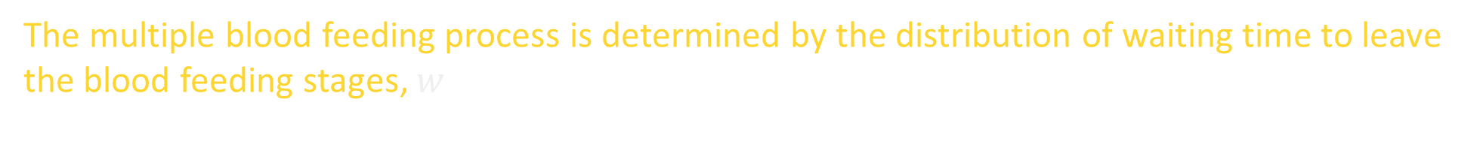


Distributed delay model
The multiple blood feeding process is determined by the distribution of waiting time to leave the blood feeding stages, $w$
$$B$$
$$L$$
$$w$$
$$V$$
species, temperature,
larval conditions,
host defensiveness,
infection status, …
$$w\sim f($$
$$)$$
Notes:
Just show L, “B”, and V compartments
Make it clear that we will be messing with the “B” compartments

Slide 34




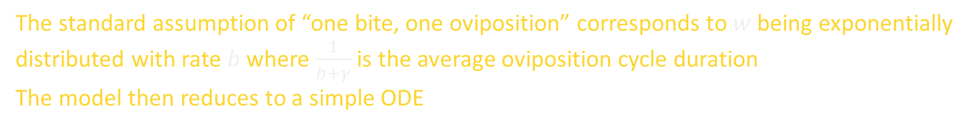

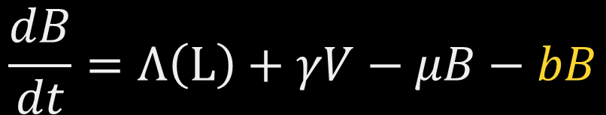

Distributed delay model: “One bite”
The standard assumption of “one bite, one oviposition” corresponds to $w$ being exponentially distributed with rate $b$ where $\frac{1}{b+γ}$ is the average oviposition cycle duration
The model then reduces to a simple ODE
$$μ$$
$$Λ$$
$$b$$
$$L$$
$$B$$
$$V$$
$$γ$$
$$w\sim \text{Exponential}\left(b\right)$$
$$\frac{dB}{dt}=Λ\left(L\right)+γV−μB−bB$$
Notes:
Just show L, “B”, and V compartments
Make it clear that we will be messing with the “B” compartments

Slide 35

Distributed delay model: $k$ bites
If instead $k$ bites are necessary for oviposition and $\frac{1}{b+γ}$ is still the average oviposition cycle duration, $w$ follows an Erlang distribution
$$B$$
$$L$$
$$w$$
$$V$$
$$w\sim \text{Erlang}\left(\text{shape}=k,\text{rate}\text{ =}b\right)$$
Notes:
Just show L, “B”, and V compartments
Make it clear that we will be messing with the “B” compartments

Slide 36






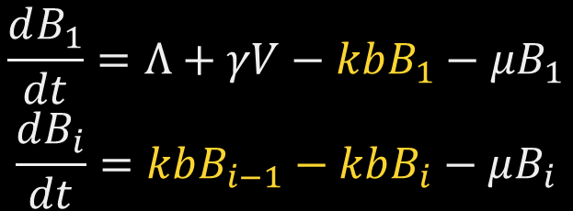
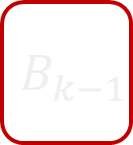





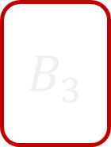

Distributed delay model: $k$ bites
The linear chain trick can then be used to reduce the model to a system of ODEs
$$μ$$
$$L$$
$$Λ$$
$$B_{1}$$
$$kb$$
$$B_{2}$$
$$kb$$
$$B_{3}$$
$$B_{k−1}$$
$$kb$$
$$B_{k}$$
$$kb$$
$$V$$
$$γ$$
$$\frac{dB_{1}}{dt}=Λ+γV−kbB_{1}−μB_{1}$$
$$\frac{dB_{i}}{dt}=kbB_{i−1}−kbB_{i}−μB_{i}$$
Notes:
Just show L, “B”, and V compartments
Make it clear that we will be messing with the “B” compartments

Slide 37
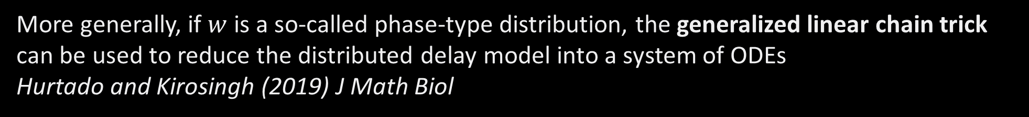
Distributed delay model: General case
More generally, if $w$ is a so-called phase-type distribution, the generalized linear chain trick can be used to reduce the distributed delay model into a system of ODEs
Hurtado and Kirosingh (2019) J Math Biol
$$B$$
$$L$$
$$w$$
$$V$$
The generalized linear chain trick (GLCT) provides a straightforward way to convert this waiting time process into a system of ODEs (Hurtado and Richards (2021) J Biol Dyn)
Notes:
Just show L, “B”, and V compartments
Make it clear that we will be messing with the “B” compartments

Slide 38
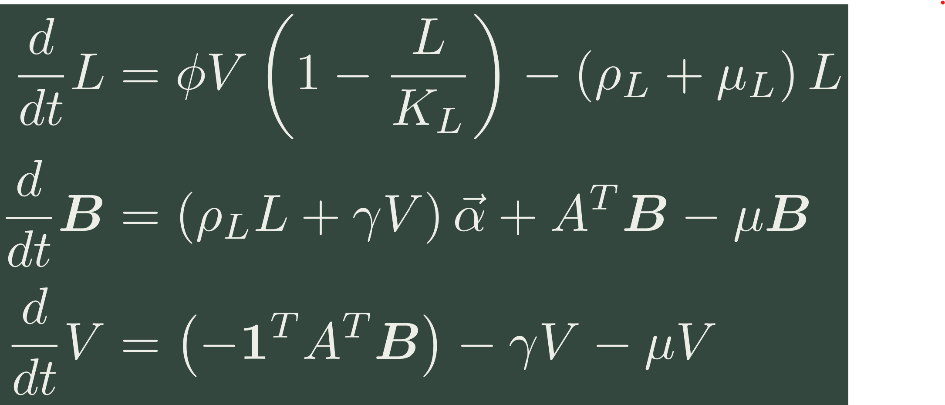
Base ODE model
Density-dependent larval recruitment
Aquatic-stage or immature:
All transitions within blood-feeding stages
Blood-feeding stages:
Larval development
Ovipositing (actively reproducing) :
From blood-feeding to oviposition, “repletion”
Notes:
Use Paul Hurtado’s formalism to express model in matrix-vector form
Explain that the biting process dynamics are encapsulated in the vector alpha and matrix A

Slide 39
Disruption model: diagram
Aquatic stage
Blood-feeding
Blood-feeding
Blood-feeding
Blood-feeding
Ovipositing
At each blood-feeding stage, a mosquito has some probability of either reaching repletion or requiring additional blood meals
The waiting time to leave the blood-feeding stages is represented by a Coxian distribution

Slide 40





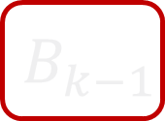

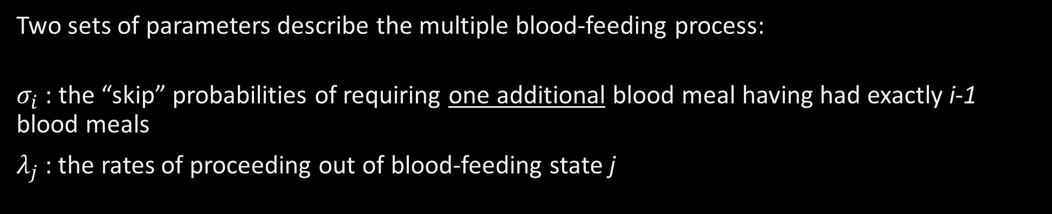
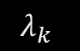


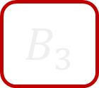
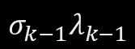

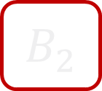


Disruption model: diagram
$$σ_{1}λ_{1}$$
$$σ_{2}λ_{2}$$
$$σ_{3}λ_{3}$$
$$σ_{k−1}λ_{k−1}$$
$$L$$
$$B_{1}$$
$$\left(1−σ_{1}\right)λ_{1}$$
$$B_{2}$$
$$\left(1−σ_{2}\right)λ_{2}$$
$$B_{3}$$
$$B_{k−1}$$
$$\left(1−σ_{k−1}\right)λ_{k−1}$$
$$B_{k}$$
$$λ_{k}$$
$$V$$
$$γ$$
Two sets of parameters describe the multiple blood-feeding process:
$σ_{i}$ : the “skip” probabilities of requiring one additional blood meal having had exactly i-1 blood meals
$λ_{j}$: the rates of proceeding out of blood-feeding state j

Slide 41
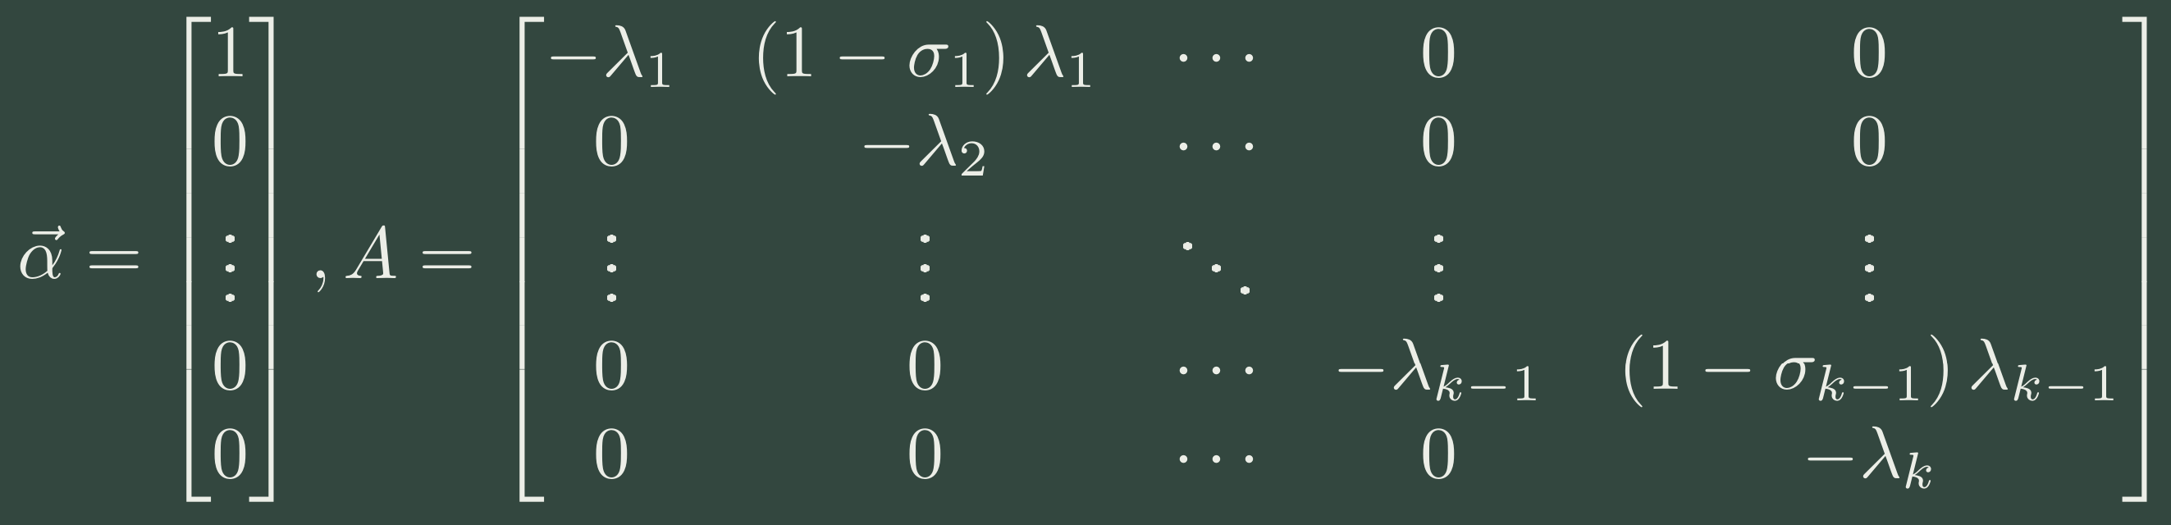
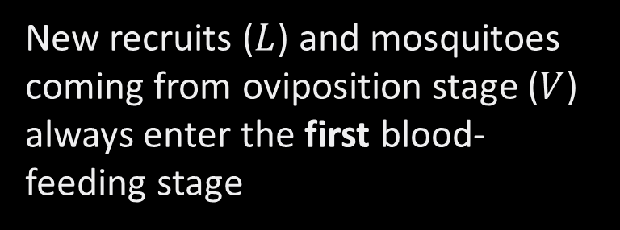
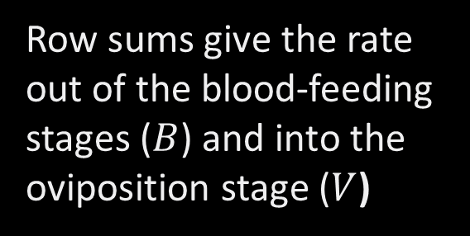
Disruption model: equations
New recruits ($L$) and mosquitoes coming from oviposition stage ($V$) always enter the first blood-feeding stage
Row sums give the rate out of the blood-feeding stages ($B$) and into the oviposition stage ($V$)
Notes:
GO FAST

Slide 42
Fate model: diagram
Type 1
Blood-feeding
Oviposition
Blood-feeding
Blood-feeding
Oviposition
Type 2
Aquatic stage
Type k-1
Blood-feeding
Blood-feeding
Blood-feeding
Oviposition
Type k
Blood-feeding
Blood-feeding
Blood-feeding
Blood-feeding
Oviposition
At maturity, mosquitoes are assigned a “type” that determines how many blood meals necessary for them to oviposit
Type is retained after oviposition
Notes:
The only way to reach oviposition is by finishing your chain

Slide 43
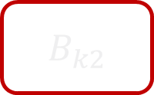

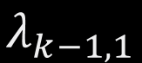
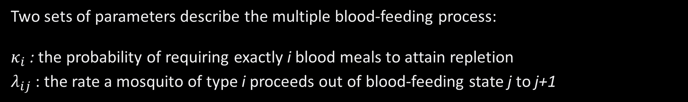


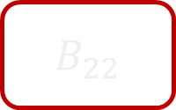
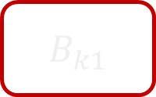
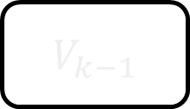
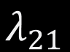


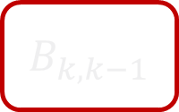
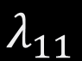
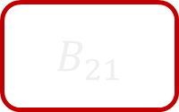
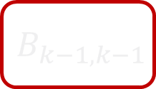


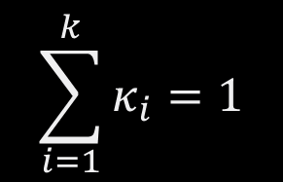
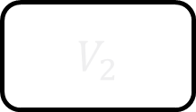

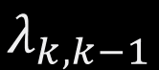
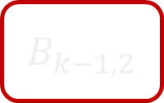

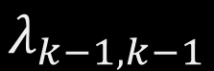

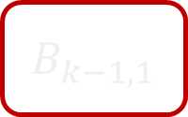


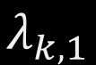



Fate model: diagram
$$γ$$
$$κ_{1}$$
$$B_{11}$$
$$λ_{11}$$
$$V_{1}$$
$$γ$$
$$B_{21}$$
$$λ_{21}$$
$$B_{22}$$
$$λ_{22}$$
$$V_{2}$$
$$κ_{2}$$
$$L$$
$$γ$$
$$B_{k−1,1}$$
$$λ_{k−1,1}$$
$$B_{k−1,2}$$
$$B_{k−1,k−1}$$
$$λ_{k−1,k−1}$$
$$V_{k−1}$$
$$κ_{k−1}$$
$$γ$$
$$κ_{k}$$
$$B_{k1}$$
$$λ_{k,1}$$
$$B_{k2}$$
$$B_{k,k−1}$$
$$λ_{k,k−1}$$
$$B_{kk}$$
$$λ_{k,k}$$
$$V_{k}$$
Two sets of parameters describe the multiple blood-feeding process:
$κ_{i}$: the probability of requiring exactly i blood meals to attain repletion
$λ_{ij}$ : the rate a mosquito of type i proceeds out of blood-feeding state j to j+1
$$\sum_{i=1}^{k}{κ_{i}}=1$$

Slide 44





Fate model: equations
New recruits ($L$) and mosquitoes coming from oviposition stage ($V$) always enter the first blood-feeding stage of their respective type
Row sums give the rate out of the blood-feeding stages ($B_{ij}$) and into the oviposition stages ($V_{i}$)
Notes:
GO FAST

Slide 45


Fate model: equations alt.
Notes:
GO FAST
All vectors are the “appropriate” lengths. This has a more compact form but can be more challenging to work with

Slide 46
Case studies: disruption vs. destiny
“Disruption” model
“Fate” model
Multiple blood feeding is driven by interruption during feeding
May be due to host defensive behaviors or
Survival strategy of mosquito to avoid being killed
Mosquitoes may need more or fewer blood meals according to amount of nutrients attained in immature stages
Past research has shown body size/condition associated with need for more blood meals
Notes:
Consider dropping and stating this stuff on the diagram slides

Slide 47


Disruption model
Fate model
Notes:
Explain how the idea of “type” can be interpreted in both models:
A mosquito of “type i” needs to take exactly i blood meals to be able to attain repletion and oviposit

Slide 48


Disruption model
Fate model

Slide 49
Analytic results
Equilibria and local stability

Slide 50

Theorem: Stability of equilibria
Both models admit two equilibria: an extinction and a positive equilibrium. There is a quantity $R$, depending only on the model parameters, such that:
If $R>1$, the positive equilibrium exists and is locally asymptotically stable and the extinction equilibrium is unstable
If $R<1$, the positive equilibrium does not exist and the extinction equilibrium is locally asymptotically stable
We call $R$the basic reproductive number and it can be decomposed as $R=ωθ$ where
$ω$ is the average number of mature mosquitoes recruited in a single oviposition event. This quantity is the same in both models.
$θ$ is the average number of oviposition events of an average newly emerged adult mosquito.

Slide 51



Disruption model: Reproductive number
Reproductive number:
$$R=ωθ$$
$$θ=τ{\left(1−τ\left(\frac{γ}{γ+μ}\right)\right)}^{−1}$$
Average number of oviposition events in a single lifespan:
Avg. number of gonotrophic cycles
Probability of surviving from stage $B_{1}$ to $V$:
Prob. survive the first i stages without “skipping” to the oviposition stage earlier

Slide 52



Fate model: Reproductive number
Reproductive number:
$$R=ωθ$$
$$θ=\sum_{i=1}^{k}{κ_{i}τ_{i}{\left(1−τ_{i}\left(\frac{γ}{γ+μ}\right)\right)}^{−1}}$$
Average number of oviposition events in a single lifespan:
Avg. number of gonotrophic cycles for type i mosquito
Probability of surviving from stage $B_{i1}$ to $V_{i}$:

Slide 53



Comparing $R=ωθ$
Disruption
Fate
$θ=τ{\left(1−τ\left(\frac{γ}{γ+μ}\right)\right)}^{−1}$
$τ$ is a polynomial of degree $k+1−i$ of the probability $σ_{i}$
$$θ=\sum_{i=1}^{k}{κ_{i}τ_{i}{\left(1−τ_{i}\left(\frac{γ}{γ+μ}\right)\right)}^{−1}}$$
$θ$, and hence $R$, is linear in the probabilities $κ_{i}$

Slide 54


Biting pressure
We consider the biting pressure, the total number of bites per unit time at the positive equilibrium, induced by the mosquito population
Roughly, the maximum contact rate between hosts and vectors
Disruption model
Fate model
$$β^{\text{D}}=\sum_{i=1}^{k}{λ_{i}B_{i}^{∗}}$$
$$β^{\text{F}}=\sum_{i=1}^{k}{\sum_{j=1}^{i}{λ_{ij}B_{ij}^{∗}}}$$

Slide 55
Parameterization & Numerical results
How do differences in biting process dynamics impact transmission potential?

Slide 56


Comparative parameters
Distinct parameters of the models are: the rates ($λ_{i}$ or $λ_{ij}$) and probabilities ($σ_{i}$ or $κ_{i}$)
Notes:
The two models are distinct. We want ways to set the sigma’s, kappa’s, and lambda’s so that the models are in some sense comparable.
We consider scenarios for the rates (lambda’s) and probabilities (sigma’s or kappa’s)

Slide 57



Rate $\left(λ\right)$ assumptions
Equal rates: All biting rates are equal to a fixed rate lambda
Simplest way to parameterize the rates but could over-accentuate the differences between the two
Equal cycle durations
No matter the “type” of mosquito, the average duration to reach oviposition is the same ($1/λ$)
$$λ_{i}=λ_{ij}=λ$$
$$λ_{1}=σ_{1}λ \\ λ_{i}=\left(\frac{σ_{i}}{2σ_{i−1}−1 }\right)λ_{i−1}$$
Disruption
$$λ_{ij}=iλ$$
Fate
Notes:
Notice that the second assumption has relates the probabilities and rates for the Disrupt model

Slide 58


Probability $\left(σ \text{or} κ\right)$ assumptions
Equal numbers of mosquitoes of each type at equilibrium (neglecting mortality) $σ_{i}=\frac{1}{k+1−i} κ_{i}=\frac{1}{k}$
Decreasing numbers: The likelihood of a type i+1 mosquito is reduced by $α$ from a type i mosquito $σ_{i}={\left(\sum_{j=0}^{k−i}{α^{j}}\right)}^{−1} κ_{i+1}=ακ_{i}$
Notes:
Remember that the bounds prescribed by Rate assumption 2 require that sigma_i > 0.5, in particular sigma_1 > ½ which places a limit on the value of alpha,as a function of k

Slide 59


Rate Assumption 1:
Equal rates
Rate Assumption 1:
Equal rates
1
2
Probability Assumption 1:
Equal numbers of each mosquito type
Probability Assumption 2:
Decreasing numbers of each mosquito type
Rate Assumption 2:
Equal cycle durations
Rate Assumption 2:
Equal cycle durations
$$λ_{i}=\left(\frac{σ_{i}}{2σ_{i−1}−1 }\right)λ_{i−1}$$
$$σ_{i}>\frac{1}{2}$$
3
Inconsistent for Disrupt model!
Probability Assumption 2:
Decreasing numbers of each mosquito type
Probability Assumption 1:
Equal numbers
$$σ_{i}=\frac{1}{k+1−i}$$
Notes:
Add hypotheses about what we think might happen
Numerical results for the first row (or maybe just case 1) and then explain why the one case is inconsistent

Slide 60



Biting pressure increases with the maximum number of blood meals, $k_{\text{max}}$ (but not 1-1)
n-fold increase in biting pressure when $k_{max}⁡$ increases from 1 to 5

Slide 61

Case 3: Equal cycle durations & Decreasing numbers greatest difference when biting is slow, lifespan is short
% change in biting pressure between Disrupt and Fate
Notes:
we also considered these other two cases but there weren't major differences

Slide 62
Key takeaways
Multiple blood feeding is:
A common phenomenon
Straightforward to model
Impactful for contact dynamics
Maybe the exact mechanisms aren’t important
Future directions:
Incorporate infection dynamics, particularly EIP
Dwell-time distribution fitting algorithms and parameter identifiability
Explore trade-offs between multiple blood feeding and host defensiveness

Slide 63

Thank you for your attention!
Thank you to Suzanne Lenhart, Wandi Ding, and Christina Edholm for the invitation to speak in this session!
Supported by the National Science Foundation under Grant No. 2316455
Contact: kyledahlin@vt.edu

Slide 64

Baseline parameters (independent of biting process)
Symbol | Parameter | Value | Notes
$$φ$$ | Eggs per female per day | $$30$$
$$K_{L}$$ | Larval carrying capacity | $$300$$
$$μ_{L}$$ | Intrinsic mortality of larvae | $$1/15$$ | 68% prob. of survival for larvae
$$ρ_{L}$$ | Larval maturation rate | $$1/7$$ | Average 7 day maturation period
$$γ$$ | Return to blood feeding rate | $$1/3$$ | Average 3 day oviposition period
$$μ$$ | Adult mortality rate | Varied from $1/7$ to $1/28$ | Corresponds to 1 to 4 week life spans
$$ω$$ | Newly emerged adults per female per oviposition cycle | Ranges from 43 to 55 | Dependent on $μ$
Notes:
These are the same in both models, generally they do not have to do with the biting process
We set a fixed maximum number of blood meals for now (will explore how changing this impacts results later)

Slide 65

Case 1: Equal rates & Equal numbers no substantial differences between models

Slide 66

Case 2: Equal rates & Decreasing numbers no substantial differences between models

Slide 67
Conclusions & Future direction
The GLCT gives us a flexible and straightforward way to model complex blood feeding dynamics
Mechanistically distinct blood feeding processes can lead to similar levels of transmission potential – but highly dependent on parameterization
Incorporate fitness trade-offs of multiple blood feeding: increase in mortality due to host defensiveness at each feeding attempt
Examine how mosquito biting persistence and host defensiveness together determine transmission potential

Slide 68
Title here.
Subtitle

Slide 69
Title of slide.
Text box. The easiest thing to do to keep the text formatting the same is to copy and paste this box and just erase the text and replace it.
If you don’t want to do that, just make a new textbox and change the font to Arial. I think Arial is easy to read, so that’s what I used for everything.

Slide 70
Title of slide.
Text box. The easiest thing to do to keep the text formatting the same is to copy and paste this box and just erase the text and replace it.
If you don’t want to do that, just make a new textbox and change the font to Arial. I think Arial is easy to read, so that’s what I used for everything.

Slide 71
Copy + paste this whole slide to create a new one but with titles that are all in the same place.

Slide 73
All of these colors should pop up in the recently used when you want to pick a new color.
BOLD – HEX CODE FCD530.
Use this for contrast or highlight.
DARK – HEX CODE 241920. can use this instead of black
BOLD – HEX CODE 519872. can use this for contrast or highlight.
BOLD – HEX CODE A4B494.
Use this for contrast or highlight.
BOLD – HEX CODE 455F55. can use this for contrast or highlight.
WHITE – HEX CODE ECEEE7. can use this instead of white

Slide 74
Copy + paste this whole slide to create a new one but with titles that are all in the same place.
Ignore the last one in the recent colors though, that’s an accident. The first five in that list are the ones that you can use.
HERE ARE THEIR HEX CODES AGAIN SO YOU CAN USE IT
BLACK - 241920
BOLD 1 - 519872
BOLD 2 - 455F55
WHITE - ECEEE7
BOLD 3 - A4B494

